Slide 1
Breast Cancer Classification
Dataset: BRACS
Transfer Learning in PyTorch (ResNet34)
IMPROVED BREAST CANCER DIAGNOSIS THROUGH TRANSFERLEARNING ON HEMATOXYLIN AND EOSIN STAINED HISTOLOGY IMAGES (Resnet50)

Slide 2
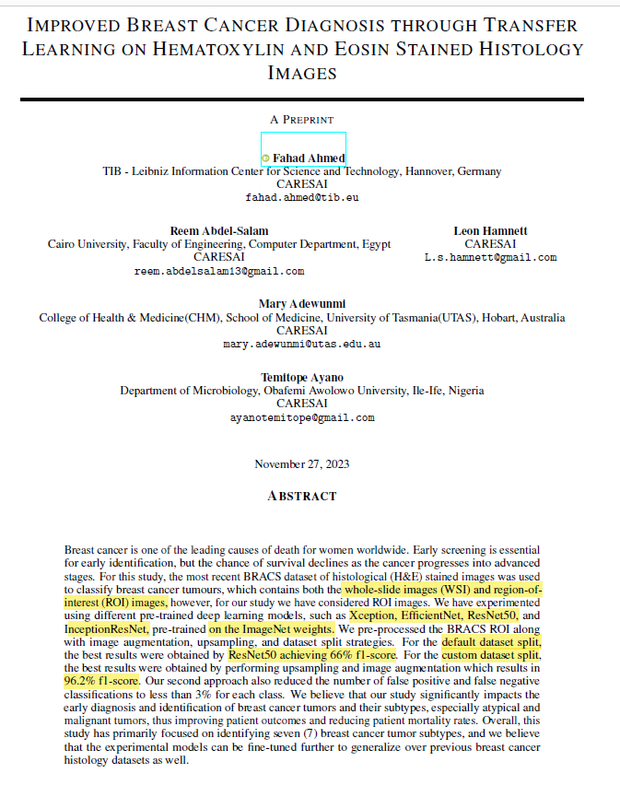

Slide 3

Breast Cancer Diagnosis through Transfer Learning
Utilizing Hematoxylin and Eosin Stained Histology Images
Dataset Used:
BRACS dataset, which includes images stained with Hematoxylin and Eosin.
Machine Learning Models Used:
ResNet50
Xception
EfficientNet
InceptionResNet
Training Details:
The initial training is on the ImageNet dataset followed by application to the BRACS dataset.
Techniques:
Transfer learning, image augmentation, and upsampling to enhance model performance.

Slide 4
Preprocessing:
Huge dataset:
The BRACS dataset is a gigapixel dataset (high resolution)
1 st path: applying transfer learning on reduced-resolution image
Decrease the resolution of images by resizing and graying out the noise (Giga to Mega)
2nd path: applying transfer learning on ROI instead of WSI
Apply tiling and patching to the high and low-resolution images
Data Augmentation:
flip (reversing left-right or up-down orientation)
rotating
brightening and darkening
resizing
cropping
blurring and sharpening

Slide 5
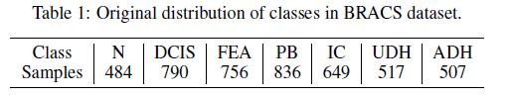
Non uniformity & Data Upsampling:
we have imbalance data in BRACS:
To balance classes in the dataset:
batch-balanced sampler
weighted batch sampler
and general upsampling
Transfer learning:
Xception
EfficientNet
ResNet50
ConvNextTinyV2
InceptionResNet
optimizer: Adam
learning rate : 1e-3
1e-2 < weight decay <1e-5

Slide 6
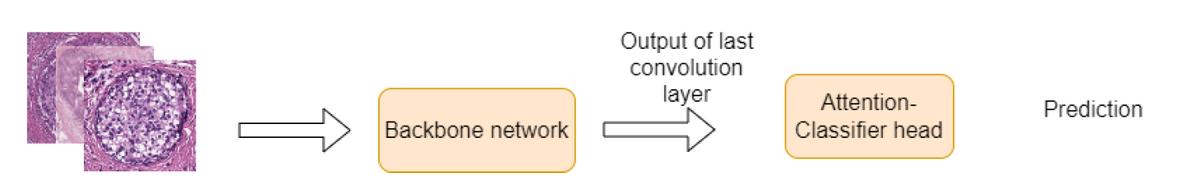
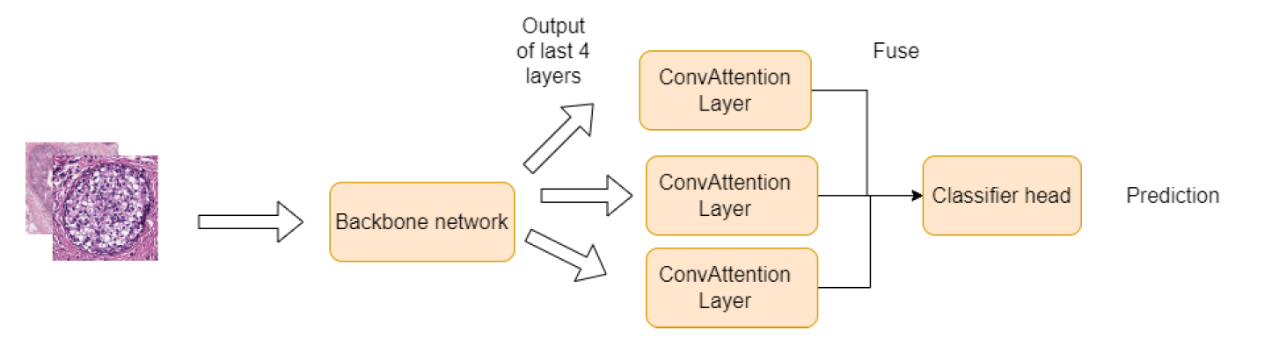
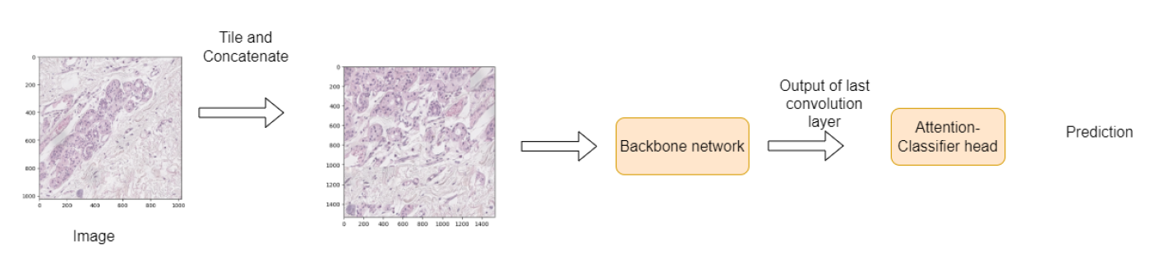
Pyramid model A: First architecture:
Pyramid model B : Second architecture:
Tile model: Image tiling and transfer learning

Slide 7
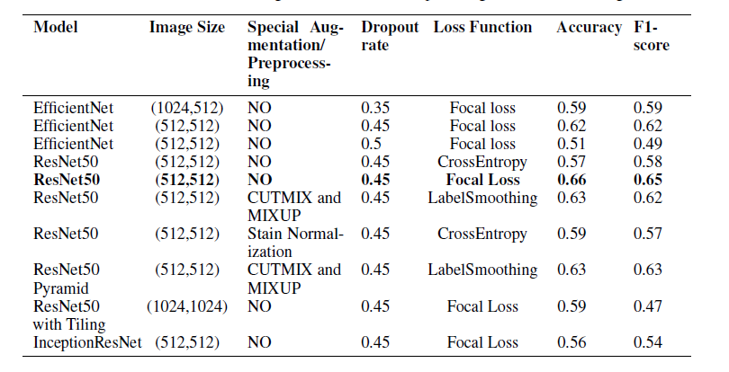
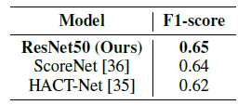
Result:

Slide 8

Project Overview
Data Loading and Exploration
Data Preprocessing
Exploratory Data Analysis (EDA)
Correlation Analysis
Model Training and Evaluation
Notes:
The project includes the following steps:
Data Loading and Exploration: The dataset is loaded using pandas and explored by examining the data types, summary statistics, and missing values.
Data Preprocessing: The dataset is preprocessed by dropping unnecessary columns and encoding the diagnosis labels (benign or malignant) to numerical values.
Exploratory Data Analysis (EDA): The distributions of different features are visualized using histograms to gain insights into the data.
Correlation Analysis: The correlation between features is analyzed by creating a correlation matrix and visualizing it as a heatmap.
Model Training and Evaluation: The dataset is split into training and testing sets. A disease classification model is defined using PyTorch, with a two-layer fully connected neural network. The model is trained on the training set using the Adam optimizer and cross-entropy loss. Finally, the trained model is evaluated on the test set to calculate the accuracy.
The project aims to classify breast mass images into benign or malignant cases, providing a potential tool for early breast cancer detection.

Slide 9
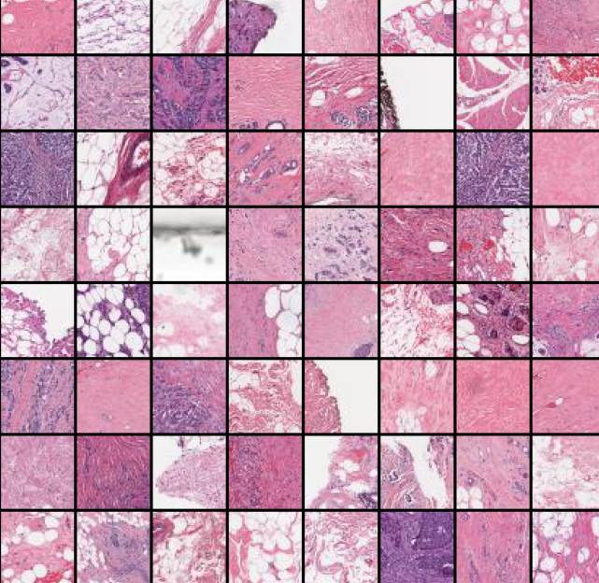
Step 1: Load the Data & Prepare the Data For Training
Data transform to tensor
Load train, validation, and test dataset
Batch size = 100
PyTorch data loader
See a sample image
Sample image

Slide 10

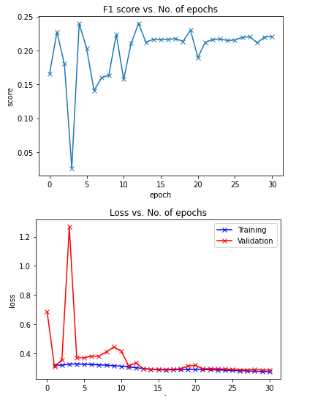
Step 2: ResNet34 Model Step 3: Train the Model
HBox(children=(FloatProgress(value=0.0, max=2016.0), HTML(value='')))
Epoch [0], last_lr: 0.0015, train_loss: 0.3192, val_loss: 0.3073, val_score: 0.2271
HBox(children=(FloatProgress(value=0.0, max=2016.0), HTML(value='')))
Epoch [1], last_lr: 0.0044, train_loss: 0.3179, val_loss: 0.3547, val_score: 0.1800
HBox(children=(FloatProgress(value=0.0, max=2016.0), HTML(value='')))
Epoch [2], last_lr: 0.0076, train_loss: 0.3254, val_loss: 1.2674, val_score: 0.0263
HBox(children=(FloatProgress(value=0.0, max=2016.0), HTML(value='')))
Epoch [3], last_lr: 0.0097, train_loss: 0.3257, val_loss: 0.3687, val_score: 0.2396
HBox(children=(FloatProgress(value=0.0, max=2016.0), HTML(value='')))
Epoch [4], last_lr: 0.0099, train_loss: 0.3248, val_loss: 0.3693, val_score: 0.2029
HBox(children=(FloatProgress(value=0.0, max=2016.0), HTML(value='')))
Epoch [5], last_lr: 0.0095, train_loss: 0.3226, val_loss: 0.3803, val_score: 0.1407
HBox(children=(FloatProgress(value=0.0, max=2016.0), HTML(value='')))
Epoch [6], last_lr: 0.0087, train_loss: 0.3201, val_loss: 0.3793, val_score: 0.1595
HBox(children=(FloatProgress(value=0.0, max=2016.0), HTML(value='')))
Epoch [7], last_lr: 0.0075, train_loss: 0.3178, val_loss: 0.4097, val_score: 0.1636
HBox(children=(FloatProgress(value=0.0, max=2016.0), HTML(value='')))
Epoch [8], last_lr: 0.0061, train_loss: 0.3146, val_loss: 0.4425, val_score: 0.2237
HBox(children=(FloatProgress(value=0.0, max=2016.0), HTML(value='')))
Epoch [9], last_lr: 0.0046, train_loss: 0.3111, val_loss: 0.4150, val_score: 0.1574
HBox(children=(FloatProgress(value=0.0, max=2016.0), HTML(value='')))
Epoch [10], last_lr: 0.0032, train_loss: 0.3064, val_loss: 0.3140, val_score: 0.2103
HBox(children=(FloatProgress(value=0.0, max=2016.0), HTML(value='')))
Epoch [11], last_lr: 0.0019, train_loss: 0.3008, val_loss: 0.3336, val_score: 0.2396
HBox(children=(FloatProgress(value=0.0, max=2016.0), HTML(value='')))
Epoch [12], last_lr: 0.0009, train_loss: 0.2953, val_loss: 0.2926, val_score: 0.2122
HBox(children=(FloatProgress(value=0.0, max=2016.0), HTML(value='')))
Epoch [13], last_lr: 0.0002, train_loss: 0.2902, val_loss: 0.2893, val_score: 0.2164
HBox(children=(FloatProgress(value=0.0, max=2016.0), HTML(value='')))
Epoch [14], last_lr: 0.0000, train_loss: 0.2864, val_loss: 0.2894, val_score: 0.2162 Wall time: 48min 26s

